Slide 1
Operating Systems
File System
Liu Fagui

Slide 2
Content of this lecture
Review
File system Management and Optimize
  Disk Space Management
  File System backup
  File System Consistency
  File System Performance
  磁盘碎片整理
Example file systems
Summary

Slide 3
Disk Space Management
文件通常存放在磁盘上，对磁盘空间的管理是系统设计要考虑的主要问题之一
几乎所有的文件系统都将文件分割成固定大小的块（ Block）来存储，各块之间不一定相邻。

Slide 4
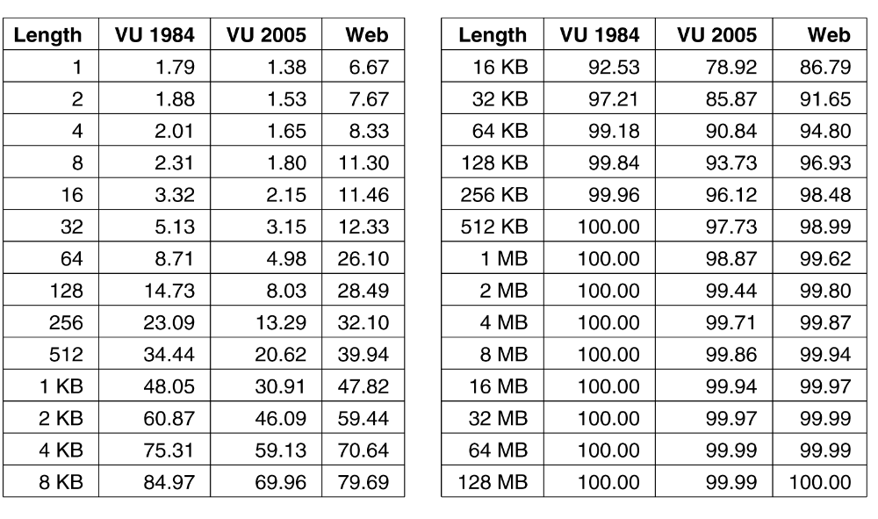
Disk Space Management
----Block Size (1)
Figure 4-20. Percentage of files smaller than a given size
(in bytes)（小于某个给定值（字节）的文件的百分数）.

Slide 5

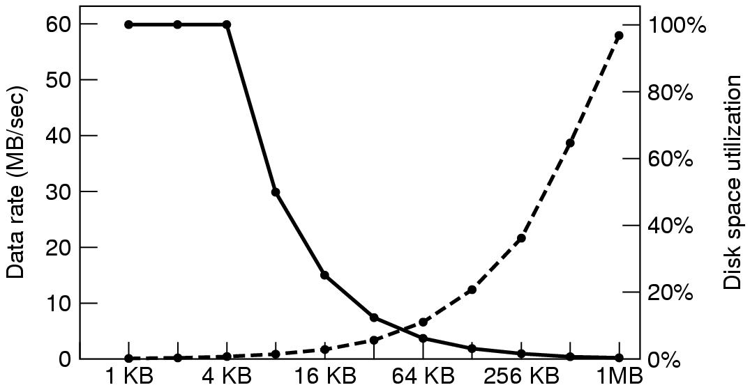

Disk Space Management –Block Size（2）
Block size
Dark line(虚线) (left hand scale) gives data rate of a disk（磁盘数据率）
Dotted line(实线) (right hand scale) gives disk space efficiency（磁盘利用率）
All files 4KB
小的块会导致低的性能但是高的空间利用率。两曲线的相交处的块大小约为64K。
读取磁盘的时间=寻道时间+旋转延迟+传送时间

Slide 6
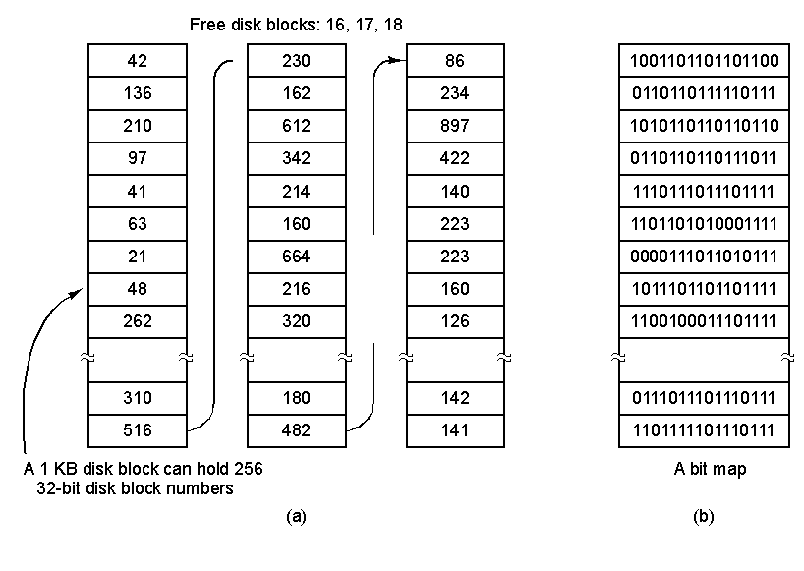
Disk Space Management
–Keeping Track of Free Blocks(1)
a)采用磁盘块链表：每个块中包含尽量多的空闲磁盘块号。如块大小为1K，32位磁盘块号，则空闲表中每个块包含255空闲块（留1位置存放指向下一块的指针）
b)采用位图：n个块的磁盘需要n位位图
Storing the free list on a linked list
A bitmap

Slide 7
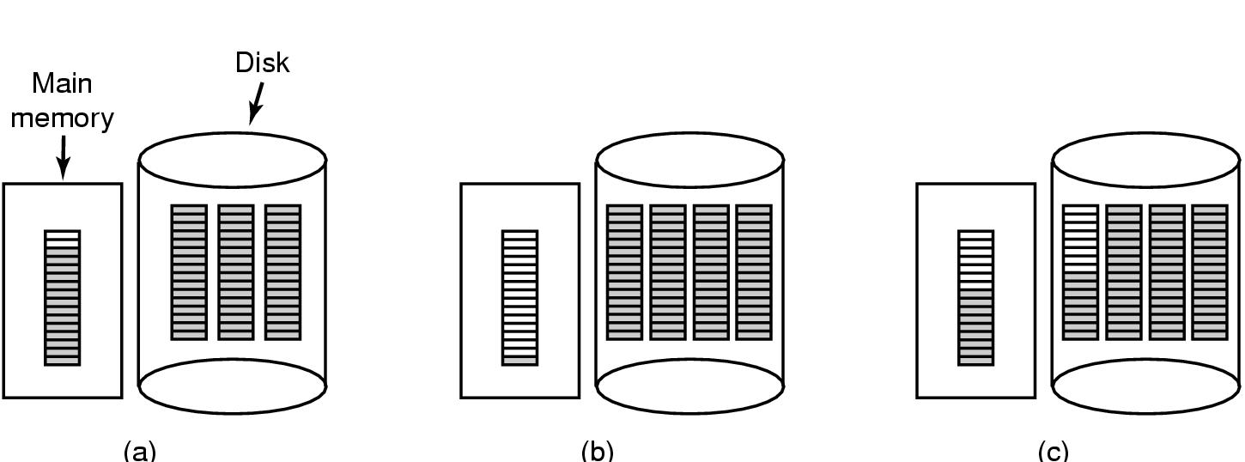


Disk Space Management
–Keeping Track of Free Blocks (2)
(a) Almost-full block of pointers to free disk blocks in RAM
  - three blocks of pointers on disk
(b) Result of freeing a 3-block file
(c) Alternative strategy for handling 3 free blocks(采用拆分满的指针块（(a)->(c)shaded entries are pointers to free disk blocks）
基本思路：保持磁盘上的大多数指针块为满的状态（减少磁盘的使用），但在内存中保留一个半满的指针块

Slide 8
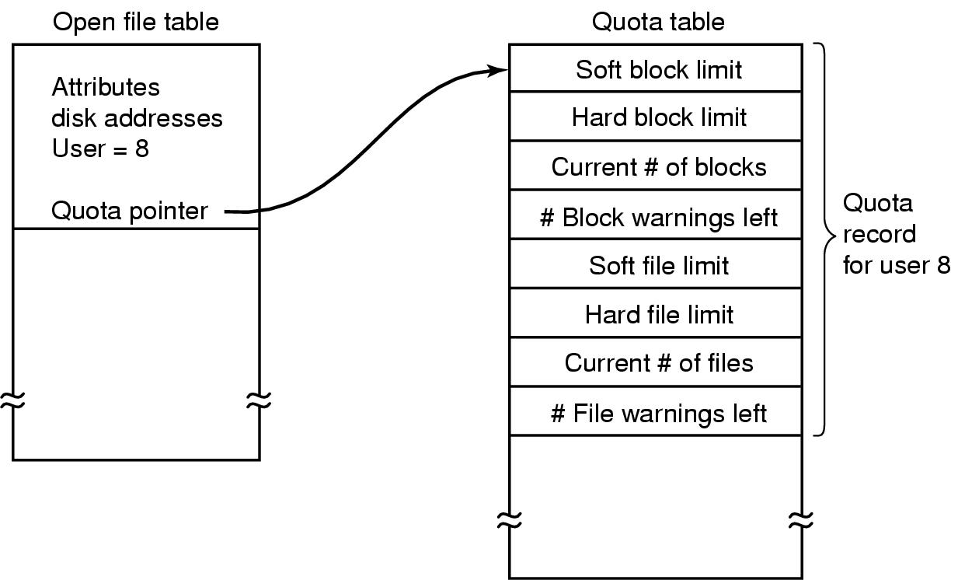
Disk Space Management –Disk Quotas（磁盘配额）
多用户OS常常提供一种强制性磁盘配额机制
Quotas are kept track of on a per-user basis in a quota table.

Slide 9
File System Backups (1)
Backups to tape are generally made to handle one of two potential problems:
Recover from disaster（从意外的灾难中恢复）.
Recover from stupidity. (从错误的操作中恢复）
转储磁盘到磁带上有两种方案：物理转储（从磁盘的第0块开始，全部按序输出到磁带上）和逻辑转储（从一个或几个指定的目录开始，递归地转储其自给定基准日期后所更改的全部文件和目录）。

Slide 10
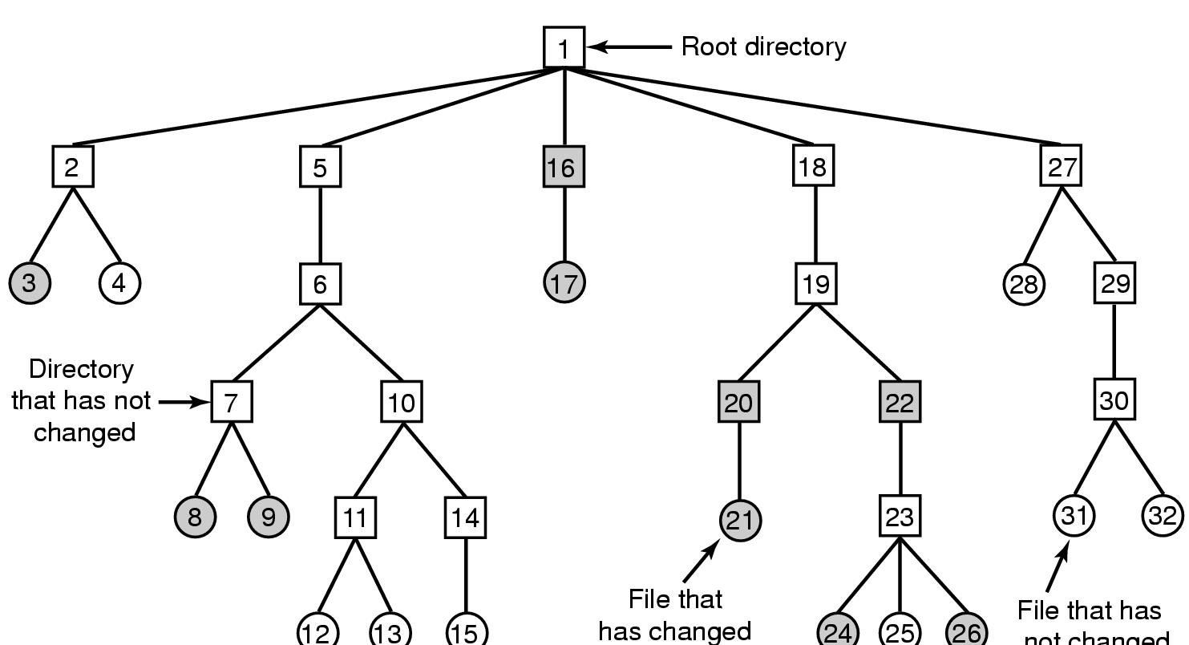
File System Backups (2)
维持一个一i节点号为索引的位图
File that has
not changed
A file system to be dumped
  squares are directories, circles are files
  shaded items, modified since last dump
  each directory & file labeled by i-node number

Slide 11
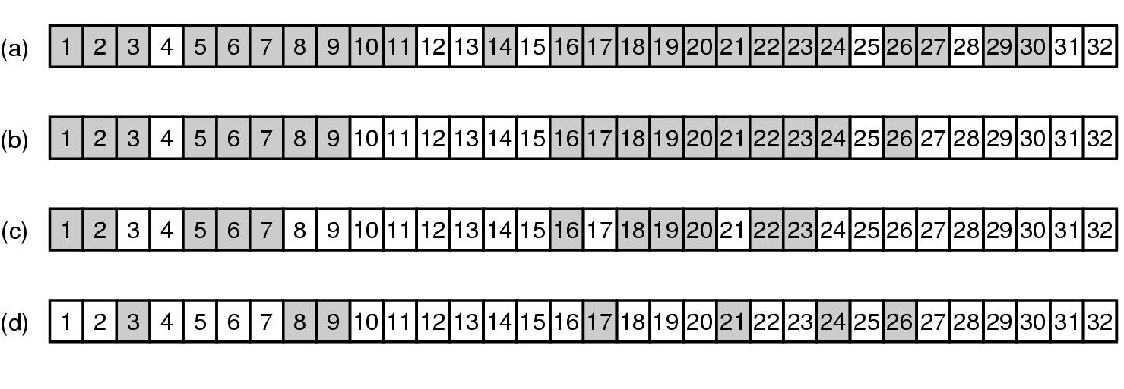
File System Backups (3)—逻辑转储
----转储通向修改过的文件或目录的路径上的所有目录
Bit maps used by the logical dumping algorithm
(a)所有修改过的文件和全部目录都在位图中标记了
(b)再次递归遍历目录树，并去掉目录树中任何不包含被修改过的文件或目录的目录上的标记
(c)以节点号为序，扫描这些i节点并转储所有标记的目录
(d) 被标记的文件被转储

Slide 12
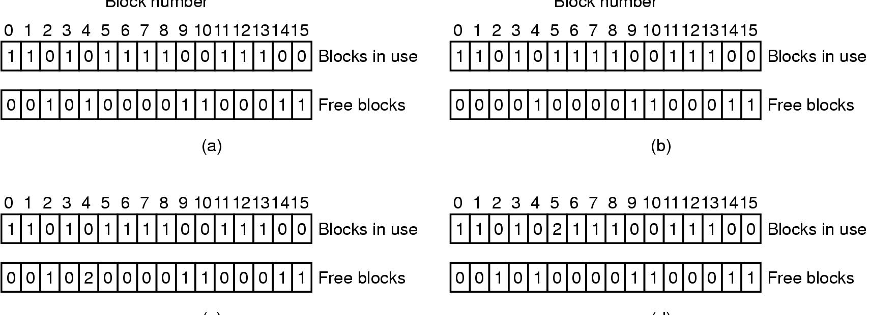
File System Consistency
----块的一致性检查和文件的一致性检查
一致
磁盘块2丢失
块4出现2次
块5出现在两个文件中
File system states
  (a) Consistent (b) missing block(系统检测程序可将其加入空闲表）
  (c) duplicate block in free list（重建空闲表） (d) duplicate data block（先分配一空闲块复制其内容并将其插入一文件中）
  UNIX用fsck, Windons 用scandisk

Slide 13
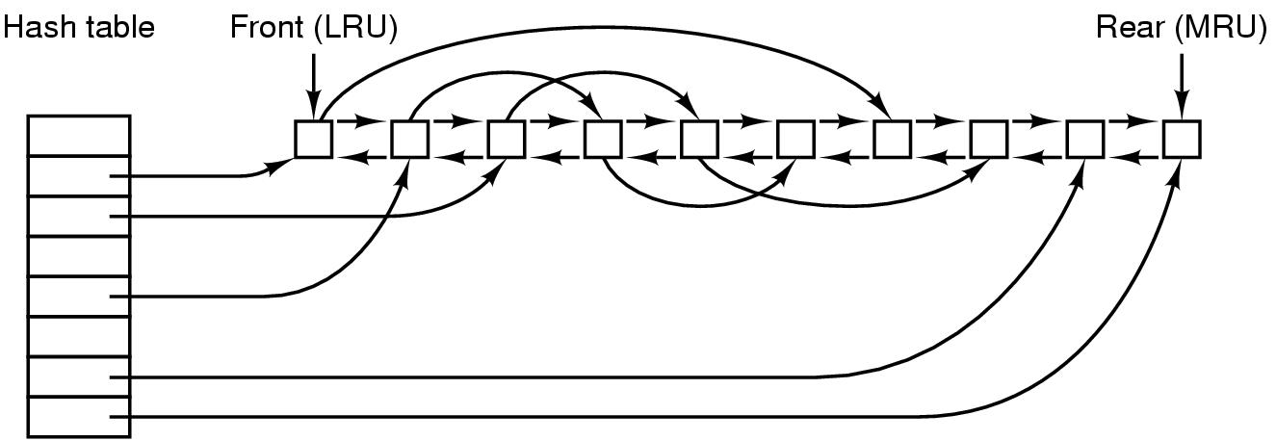
File System Performance –caching(高速缓存)
内存访问比磁盘访问快百万数量级，FS采用各种优化措施改善性能
常用算法：检查全部的读请求，查看高速缓存中是否有所需的，如存在，执行读，否则将它先读入高速缓存，再复制到所需地方。之后，对同一个块的请求都通过高速缓冲完成。
使用多的
使用少的
The block cache data structures
将设备和磁盘地址进行散列操作，在散列表中查找结果
双向链表

Slide 14
Caching (2)—LRU0淘汰算法考虑
Some blocks, such as i-node blocks, are rarely referenced two times within a short interval.
Consider a modified LRU scheme, taking two factors into account:
  Is the block likely to be needed again soon?(LRU)
  Is the block essential to the consistency of the file system?
对于第二个问题：System call sync in UNIX (强制性将全部修改过的块立即写回磁盘）

Slide 15
File System Performance –-Block Read Ahead
Get blocks into the cache before they are needed to increase the hit rate.
When the file system is asked to produce block k in a file, it schedules a read for block k+ 1.
The file system keep track of the access patterns to each open file.
块提前读只适应于实际顺序读取的文件。

Slide 16

File System Performance ----Reducing Disk Arm Motion
问题：读取很短的文件也需要两次磁盘访问：i节点、块
I-nodes placed at the start of the disk
Disk divided into cylinder groups（柱面组）
  each with its own blocks and i-nodes
特别的，固态硬盘（SSD）类似闪存（只可写入有限次数，要求写均匀）

Slide 17
File System Performance ----磁盘碎片整理
移动文件使其相邻，并将所有的空闲空间放在一个或多个大的连续区域内，如Windows的defrag.
有些文件不能移动，如日志。
固态硬盘不需要做。

Slide 18
Content of this lecture
File system Management and Optimize
Example file systems
  CD-ROM File Systems
  MS-DOS File System
  UNIX V7 File System
Summary

Slide 19
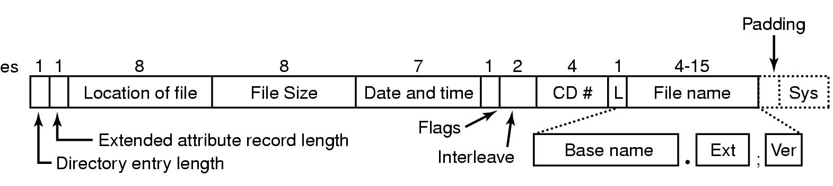
Example File Systems
CD-ROM File Systems
The ISO 9660 directory entry

Slide 20
Rock Ridge Extensions(可用于UNIX)
Rock Ridge extension fields:
PX - POSIX attributes.
PN - Major and minor device numbers.
SL - Symbolic link.
NM - Alternative name.
CL - Child location.
PL - Parent location.
RE - Relocation.
TF - Time stamps.

Slide 21
Joliet Extensions(可用于windows)
Joliet extension fields:
Long file names.
Unicode character set.
Directory nesting deeper than eight levels.
Directory names with extensions

Slide 22
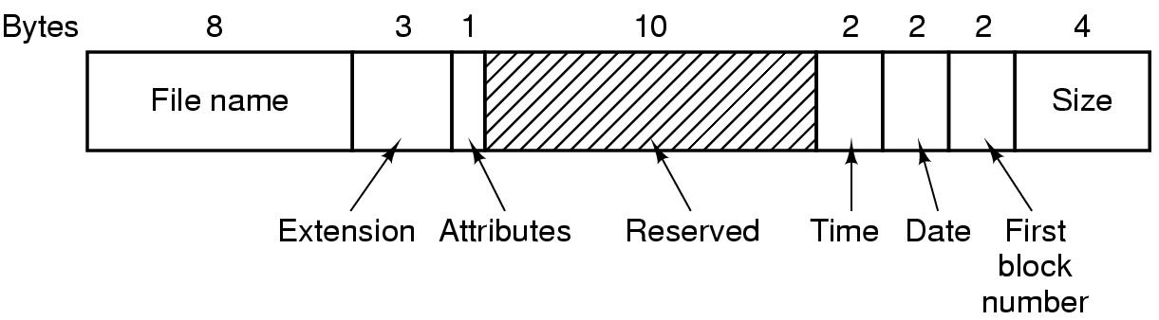
The MS-DOS File System (1)
The MS-DOS directory entry
（FAT文件系统）

Slide 23
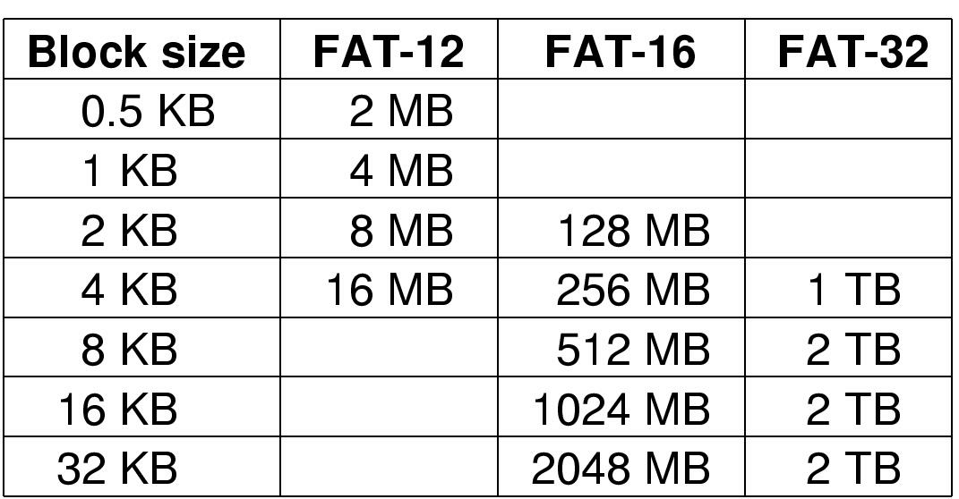
The MS-DOS File System (2)
Maximum partition for different block sizes
The empty boxes represent forbidden combinations

Slide 24
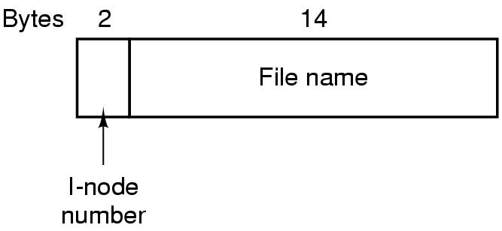
The UNIX V7 File System (1)
A UNIX V7 directory entry

Slide 25
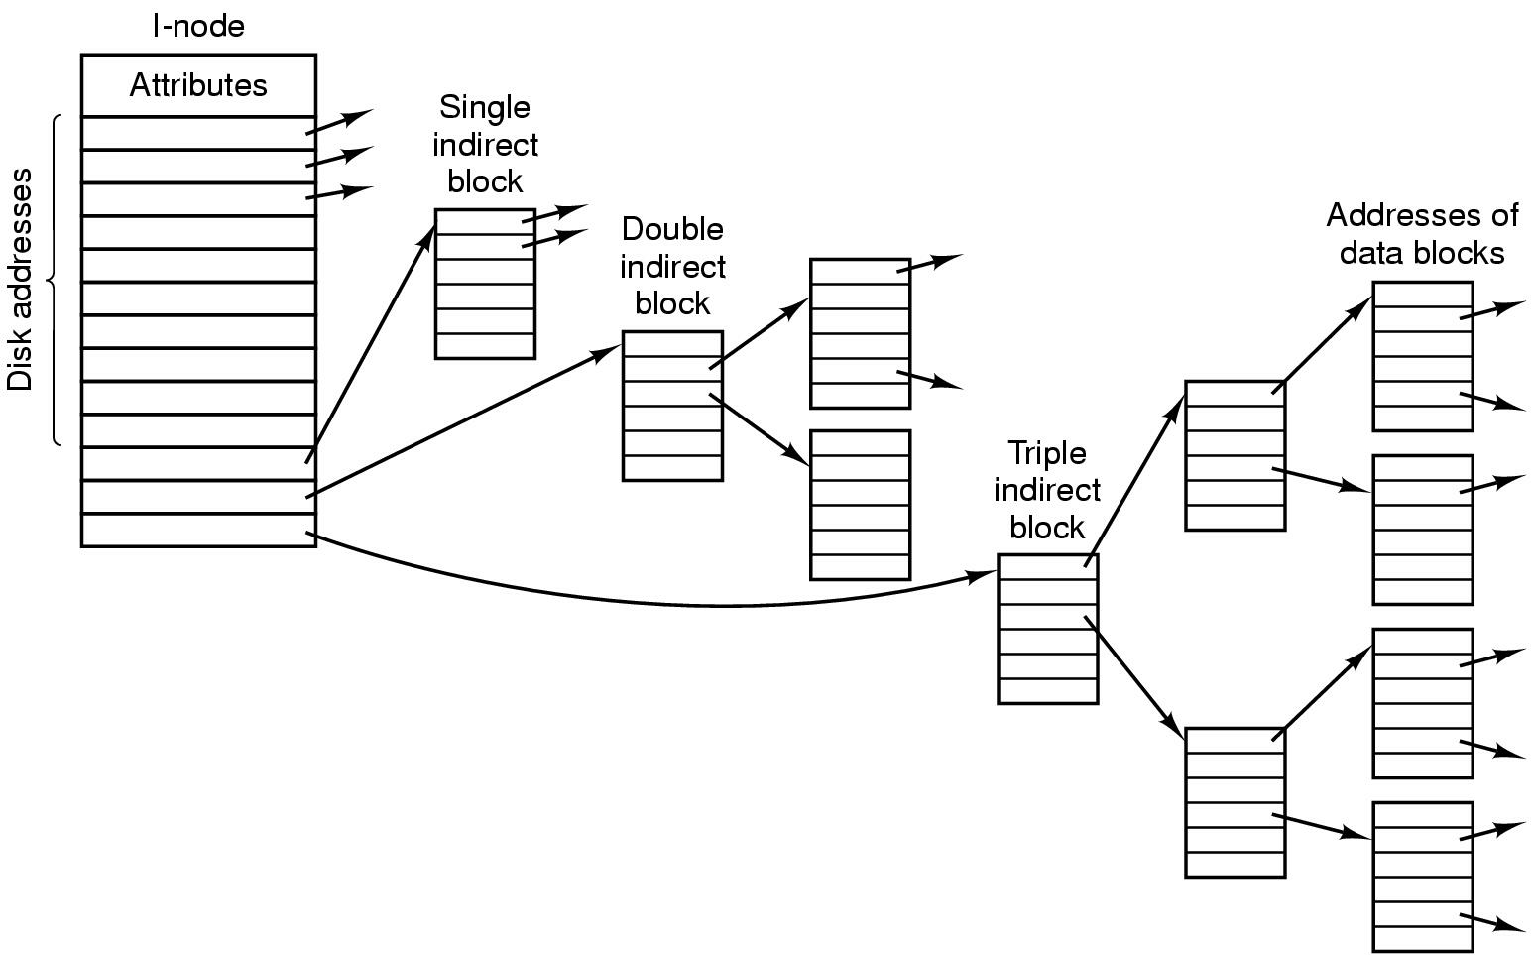
The UNIX V7 File System (2)
A UNIX i-node

Slide 26
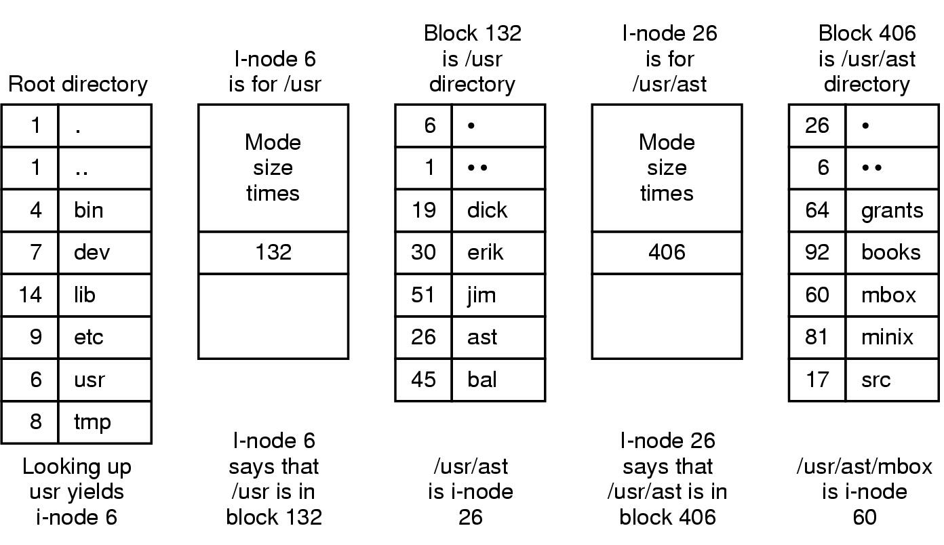






The UNIX V7 File System (3)
The steps in looking up /usr/ast/mbox

Slide 27
Summary
Files
Directories
File system implementation
File system Management and Optimize
Example file systems
Study for File Systems ，云文件系统
P186--187: 6，13，24，25，32，36,40

